Slide 1

Recipe Mate
G Dog and the Coding Ninjas

Slide 2
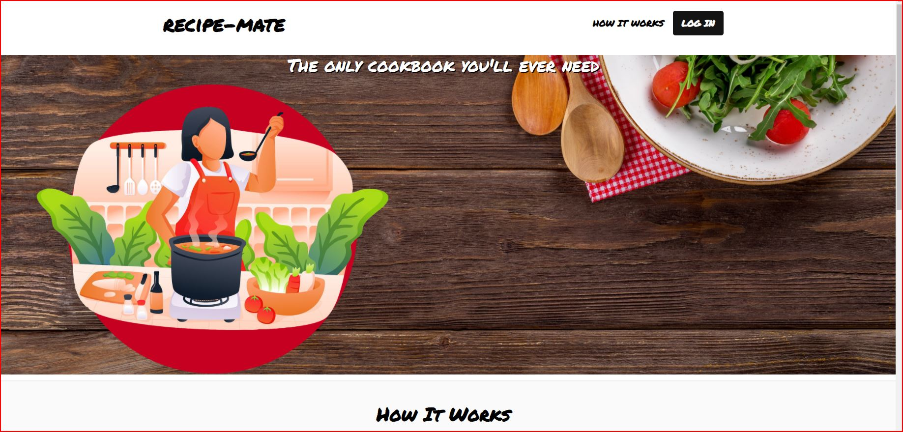
Overview
Introduction
Concept
Process
Demo
Future Development
Links
Questions

Slide 3
Recipe Mate in 30 Seconds…
It’s Tuesday and you need a quick recipe to make dinner before attending your Coding Bootcamp class. You don’t have time to run to the store before class starts. Answer – Recipe Mate! With just one search, see recipes for items you already have at home, and you can save your favorite recipes to your account.
Links are provided to further explore any of the items you see to get further details.

Slide 4
Concept
Description
Recipe Mate is a simple web tool that is a personal assistant that uses an external API to recommend recipes based on the food items presented in the search on a single page.
Motivation
Besides being a requirement for graduation, G Dog and the Coding Ninjas thought it would be useful to have a place to quickly gather recipe links based on food items you already have at home.
User Story
A user enters food items currently in their cabinet and is provided with recipes to create their meal

Slide 5
Process
Technology
dotenv
env
Heroku
HTML/CSS/ Bootstrap
Google Fonts
Edamam
Handlebars
JavaScript
MySQL
Passport
Pexels
Sequelize

Slide 6
Process (continued)
Breakdown of Tasks / Roles
Front-end: Denise, Dexter, Jerron, Sean
Back-end: Donna, Rich, Greg
Issue Tracking and Tasks: Donna
Project Manager: Greg
PowerPoint: Denise, Dexter
Testing: G Dog and the Coding Ninjas

Slide 7
Process (continued)
Challenges
Merging front end and backend routes
Error handling
Finalizing website features
Successes
Great teamwork. Everyone contributed well. Great communication.
Productive project meetings
Scrum meeting earlier in the day, followed by a working meeting with breakouts leveraged by front-end and back-end teams.
Conducted weekend meetings to finalize project.

Slide 8
A Demo of Recipe Mate

Slide 9
Directions for Future Enhancements
Ability to add notes to favorite recipes
Ability to send recipe to Alexa to show in kitchen
Add animation to images
Add categories to allow filtering of recipes
Add ingredients
Add ratings for recipes
Create meals based on meal type (breakfast, lunch, dinner, etc.)
Create on hand food items list
Create share link to allow sharing on social media or to email the recipe
Formatting clean-up of the site
Implement a forgot password feature

Slide 10
Questions?

Slide 11
Links
Deployed Application
https://boiling-cliffs-99556.herokuapp.com/
GitHub Repository
https://github.com/gehanstedt/recipe-mate

Slide 12




Thank you!

